Slide 1
How to Use Standard Tools-LiveTalk(Simultaneous interpretation Tool)​
JDU SAP SS

Slide 2
Agenda
LiveTalk Introduction
LiveTalk Installation
Software wizard and installation manual
Service ID and password
Demo

Slide 3
LiveTalk Introduction
A simultaneously multilingual interpretation software developed by FUJITSU.
Type of languages: English, Japanese, Chinese, etc.
Number of people in the chat-box
1~300
Both text and voice are available.
Text Text
Voice Text
Work dependently or stimulate with the other conference tools.
LiveTalk
LiveTalk+Lync (Skype for Business)
LiveTalk+Teams
etc.

Slide 4
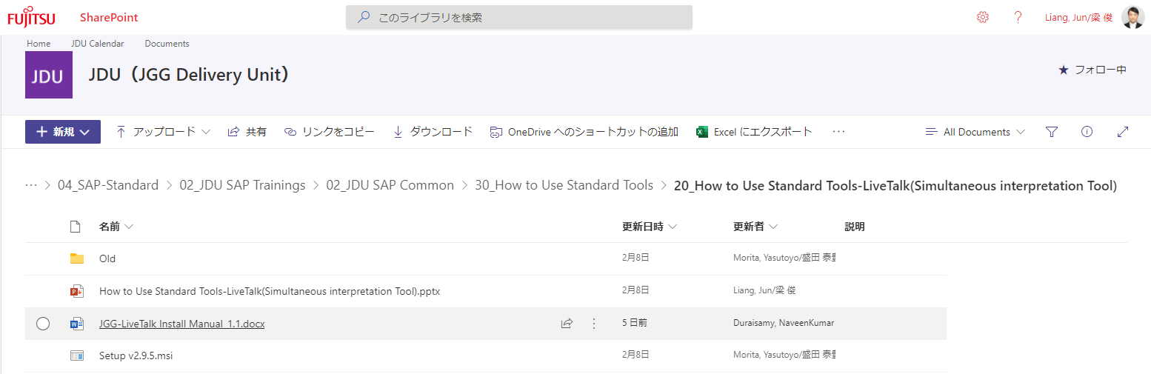
LiveTalk Installation
Software wizard and installation manual
Please download the wizard and setup the LiveTalk through JDU SPO.
Service ID and password
Request service ID and password through the Email address below:
fj-jggsap_lt_s@dl.jp.fujitsu.com
JDU SPO
Download
Location
Software wizard and introduction manual

Slide 5
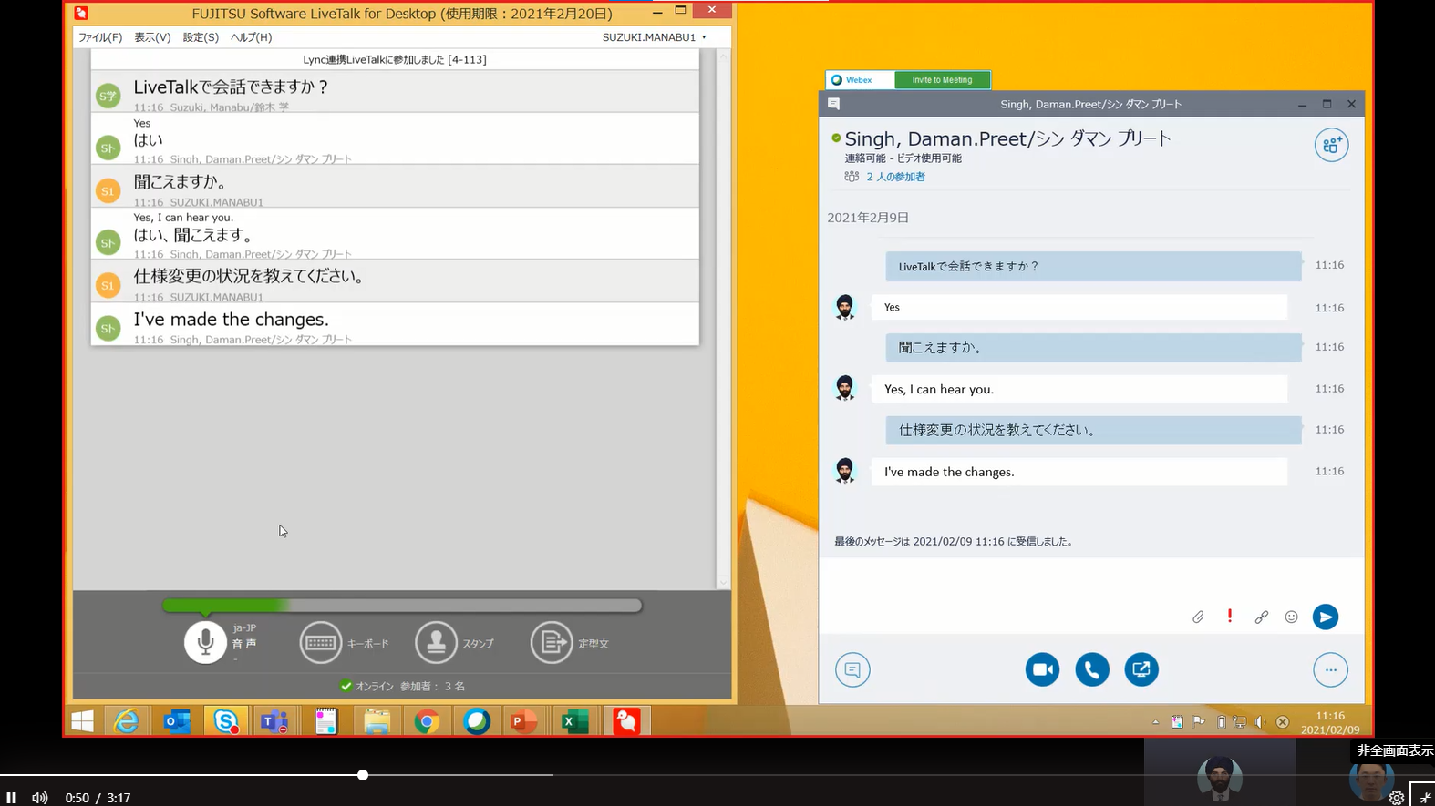
Demo
LiveTalk + Lync (Skype for Business)
A real time chat demo between a Japanese and an Indian.
The screen below shows how it works at Japanese side only.
On LiveTalk:
はい、聞こえます。
On Lync:
“Yes, I can hear you”

Slide 6
Mail Form to request service ID and password for LiveTalk
To: FJ-JGGSAP_LT_S <fj-jggsap_lt_s@dl.jp.fujitsu.com>
Subject:Request LiveTalk password
本文/Sentence
FROM-----------------------------------------------
Requesting service ID and password for LiveTalk
○所属/Affiliation
：
○氏名/Name
：
○メールアドレス/Email address
：
プロジェクト/Project
：
○利用国/Utilization Province
：
チーム管理者/Team Administrator
：
グループ(サービスライン)/Group(Service Line)
：
TO-------------------------------------------------
※○：必須/mandatory
※プロジェクトとグループ(サービスライン)のいずれか必須/either Project or Group(Service Line) is mandatory
※必ず本人が申請してください/Be sure to apply in person

